Slide 1
Semantic Search
in PSD2
Final Project - Ironhack
Author
Date
JAVIER GUIRAO
10/02/2024

Slide 2
</>
The Product
The Process
What is Semantic Search?
It involves understanding the meaning or context of words in a search query to retrieve more accurate and relevant results.
Challenges & Ideas
Conclusions

Slide 3
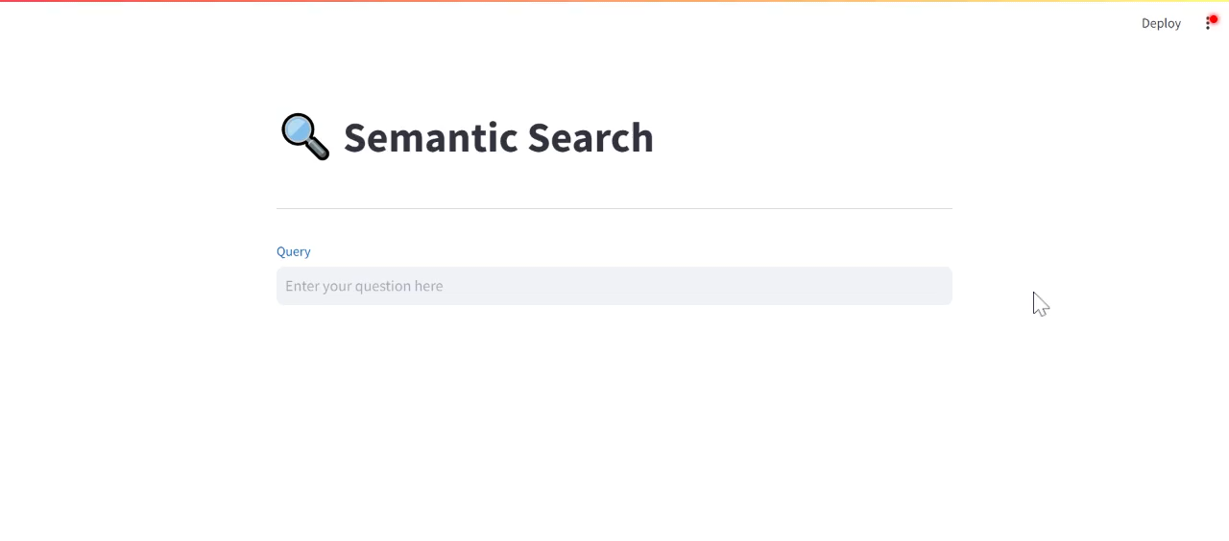
THE PRODUCT

Slide 4
THE PROCESS
PyPDF2
spaCy
Embeddings
FAISS
Results
Streamlit
Load the PDF file and extract the text
Chunk the text in sentences
Choosing the model and tokenizing the text
Indexing and searching
Retrieving the top K results
Creating a user interface

Slide 5
THE PROCESS
PyPDF2
spaCy
Embeddings
FAISS
Results
Streamlit
Load the PDF file and extract the text
Chunk the text in sentences
Choosing the model and tokenizing the text
Indexing and searching
Retrieving the top K results
Creating a user interface

Slide 6
spaCy
nlp = spacy.load('en_core_web_md')
doc = nlp(content)
sentence_df = pd.DataFrame([sent.text for sent in doc.sents], columns=['sentence'])
The spaCy model used is en_core_web_md:
Pre-trained English model
Trained on web
Medium-sized word vectors
Text is divided into sentences and stored in a DataFrame.

Slide 7
THE PROCESS
PyPDF2
spaCy
Embeddings
FAISS
Results
Streamlit
Load the PDF file and extract the text
Chunk the text in sentences
Choosing the model and tokenizing the text
Indexing and searching
Retrieving the top K results
Creating a user interface

Slide 8
Embeddings
model = SentenceTransformer('msmarco-distilbert-base-dot-prod-v3')
embeddings = model.encode([sent.text for sent in doc.sents])
What are Transformer Models?
AI models that learn the context of sequential data and generates new data out of it.
What are Embeddings?
Converting a processed text into numerical vectors.
[[-0.02727822 0.24922103 0.11857694 ... 0.31813204 -0.36375108 0.42395428]
[-0.16395971 0.3562539 0.27215397 ... 0.15404233 -0.2839619 0.29621613]
[-0.3040901 0.16620539 0.417706 ... 0.31980947 -0.09534813 0.33956677]
...
[-0.33448106 -0.3781153 0.03828233 ... 0.16015992 -0.48980263 0.47125822]
[-0.3549622 0.1788054 -0.23642029 ... 0.29252484 -0.6939322 0.37840152]
[-0.24631904 0.0571302 -0.2649193 ... 0.47142637 -0.5366712 0.5143255 ]]

Slide 9
THE PROCESS
PyPDF2
spaCy
Embeddings
FAISS
Results
Streamlit
Load the PDF file and extract the text
Chunk the text in sentences
Choosing the model and tokenizing the text
Indexing and searching
Retrieving the top K results
Creating a user interface

Slide 10
FAISS
encoded_data = np.array(embeddings.astype('float32'))
index = faiss.IndexIDMap(faiss.IndexFlatIP(768))
index.add_with_ids(encoded_data, np.array(range(0, len(embeddings))))
faiss.write_index(index, 'doc.index')
Facebook AI Similarity Search has been used to:
Create and associate an index to each vector
Choosing the MetricType and distances (Standard = Inner Product)
Adding our vectors created with SentenceTransformer
Saving the index to a file

Slide 11
THE PROCESS
PyPDF2
spaCy
Embeddings
FAISS
Results
Streamlit
Load the PDF file and extract the text
Chunk the text in sentences
Choosing the model and tokenizing the text
Indexing and searching
Retrieving the top K results
Creating a user interface

Slide 12
Results
def fetch_sentence(dataframe_idx):
sentence = sentence_df.loc[dataframe_idx, 'sentence’]
return sentence
def search(query, top_k, index, model):
t=time.time()
query_vector = model.encode([query])
top_k = index.search(query_vector, top_k)
print('>>>> Results in Total Time: {}'.format(time.time()-t))
top_k_ids = top_k[1].tolist()[0]
top_k_ids = list(np.unique(top_k_ids))
results = [fetch_sentence(idx) for idx in top_k_ids]
return results
Encoding the input query
Searching the top K most similar indices to the query
Retrieving the actual sentences corresponding to the top K indices

Slide 13
THE PROCESS
PyPDF2
spaCy
Embeddings
FAISS
Results
Streamlit
Load the PDF file and extract the text
Chunk the text in sentences
Choosing the model and tokenizing the text
Indexing and searching
Retrieving the top K results
Creating a user interface

Slide 14
Streamlit
st.title(":mag: Semantic Search")
st.divider()
query = st.text_input(label=':blue[Query]', placeholder = 'Enter your question here')
results = search(query, top_k=1, index=index, model=model)
if query == "":
st.write("")
else:
st.write(results)

Slide 15
Ideas for the future
Challenges
Understanding all the requirements of the project
Computing power
Break the text into paragraphs instead of sentences
Generative text implementation

Slide 16

Conclusion
Wonderful opportunity to dive into NLP
PyPDF2 is a cool library for working with PDF files

Slide 17

Thank you!
Bootcamp is over

